Slide 1
Natural Language Processing
Students:
Ngô Anh Tuấn
Nguyễn Mạnh Cường
Hoàng Thái Sơn
Phạm Việt Dương
Final Project
Applications of NLP in Question Answering
Teacher:
Assoc. Prof. Lê Hồng Phương

Slide 2
Agenda
Setup python environment
How to load NLP models of Hugging Face and testing model on local
Use hugging face spaces to testing models
Loading RecGPT-7B-Instruct of VIN-AI
Use RecGPT-7B-Instruct to question and answer
Loading Roberta model
Using imdb dataset to fine tune roberta

Slide 3
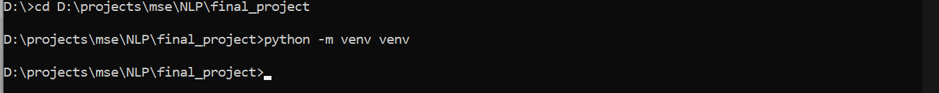

Install python https://www.python.org/downloads/
Setup python environment
Create new python environment
Active virtual environment

Slide 4
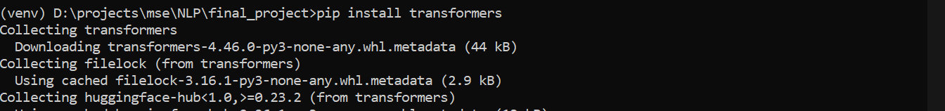

Install transformers library
Setup python environment
Install torch library

Slide 5
2. Loading model from hugging face
Step 1: Go to the model’s description page. In this example, our team is using xlm-roberta-base
Step 2: Use example code to loading model
from transformers import AutoTokenizer, AutoModelForMaskedLM
tokenizer = AutoTokenizer.from_pretrained('xlm-roberta-base')
model = AutoModelForMaskedLM.from_pretrained("xlm-roberta-base")
# prepare input
text = "Replace me by any text you'd like."
encoded_input = tokenizer(text, return_tensors='pt')
# forward pass
output = model(**encoded_input)

Slide 6
History
Founded in 2020, Contoso started from the idea that businesses require better tools to collaborate with each other. Contoso saw a gap in the market and jumped on the opportunity to create these tools for all companies to collaborate efficiently.

Slide 7
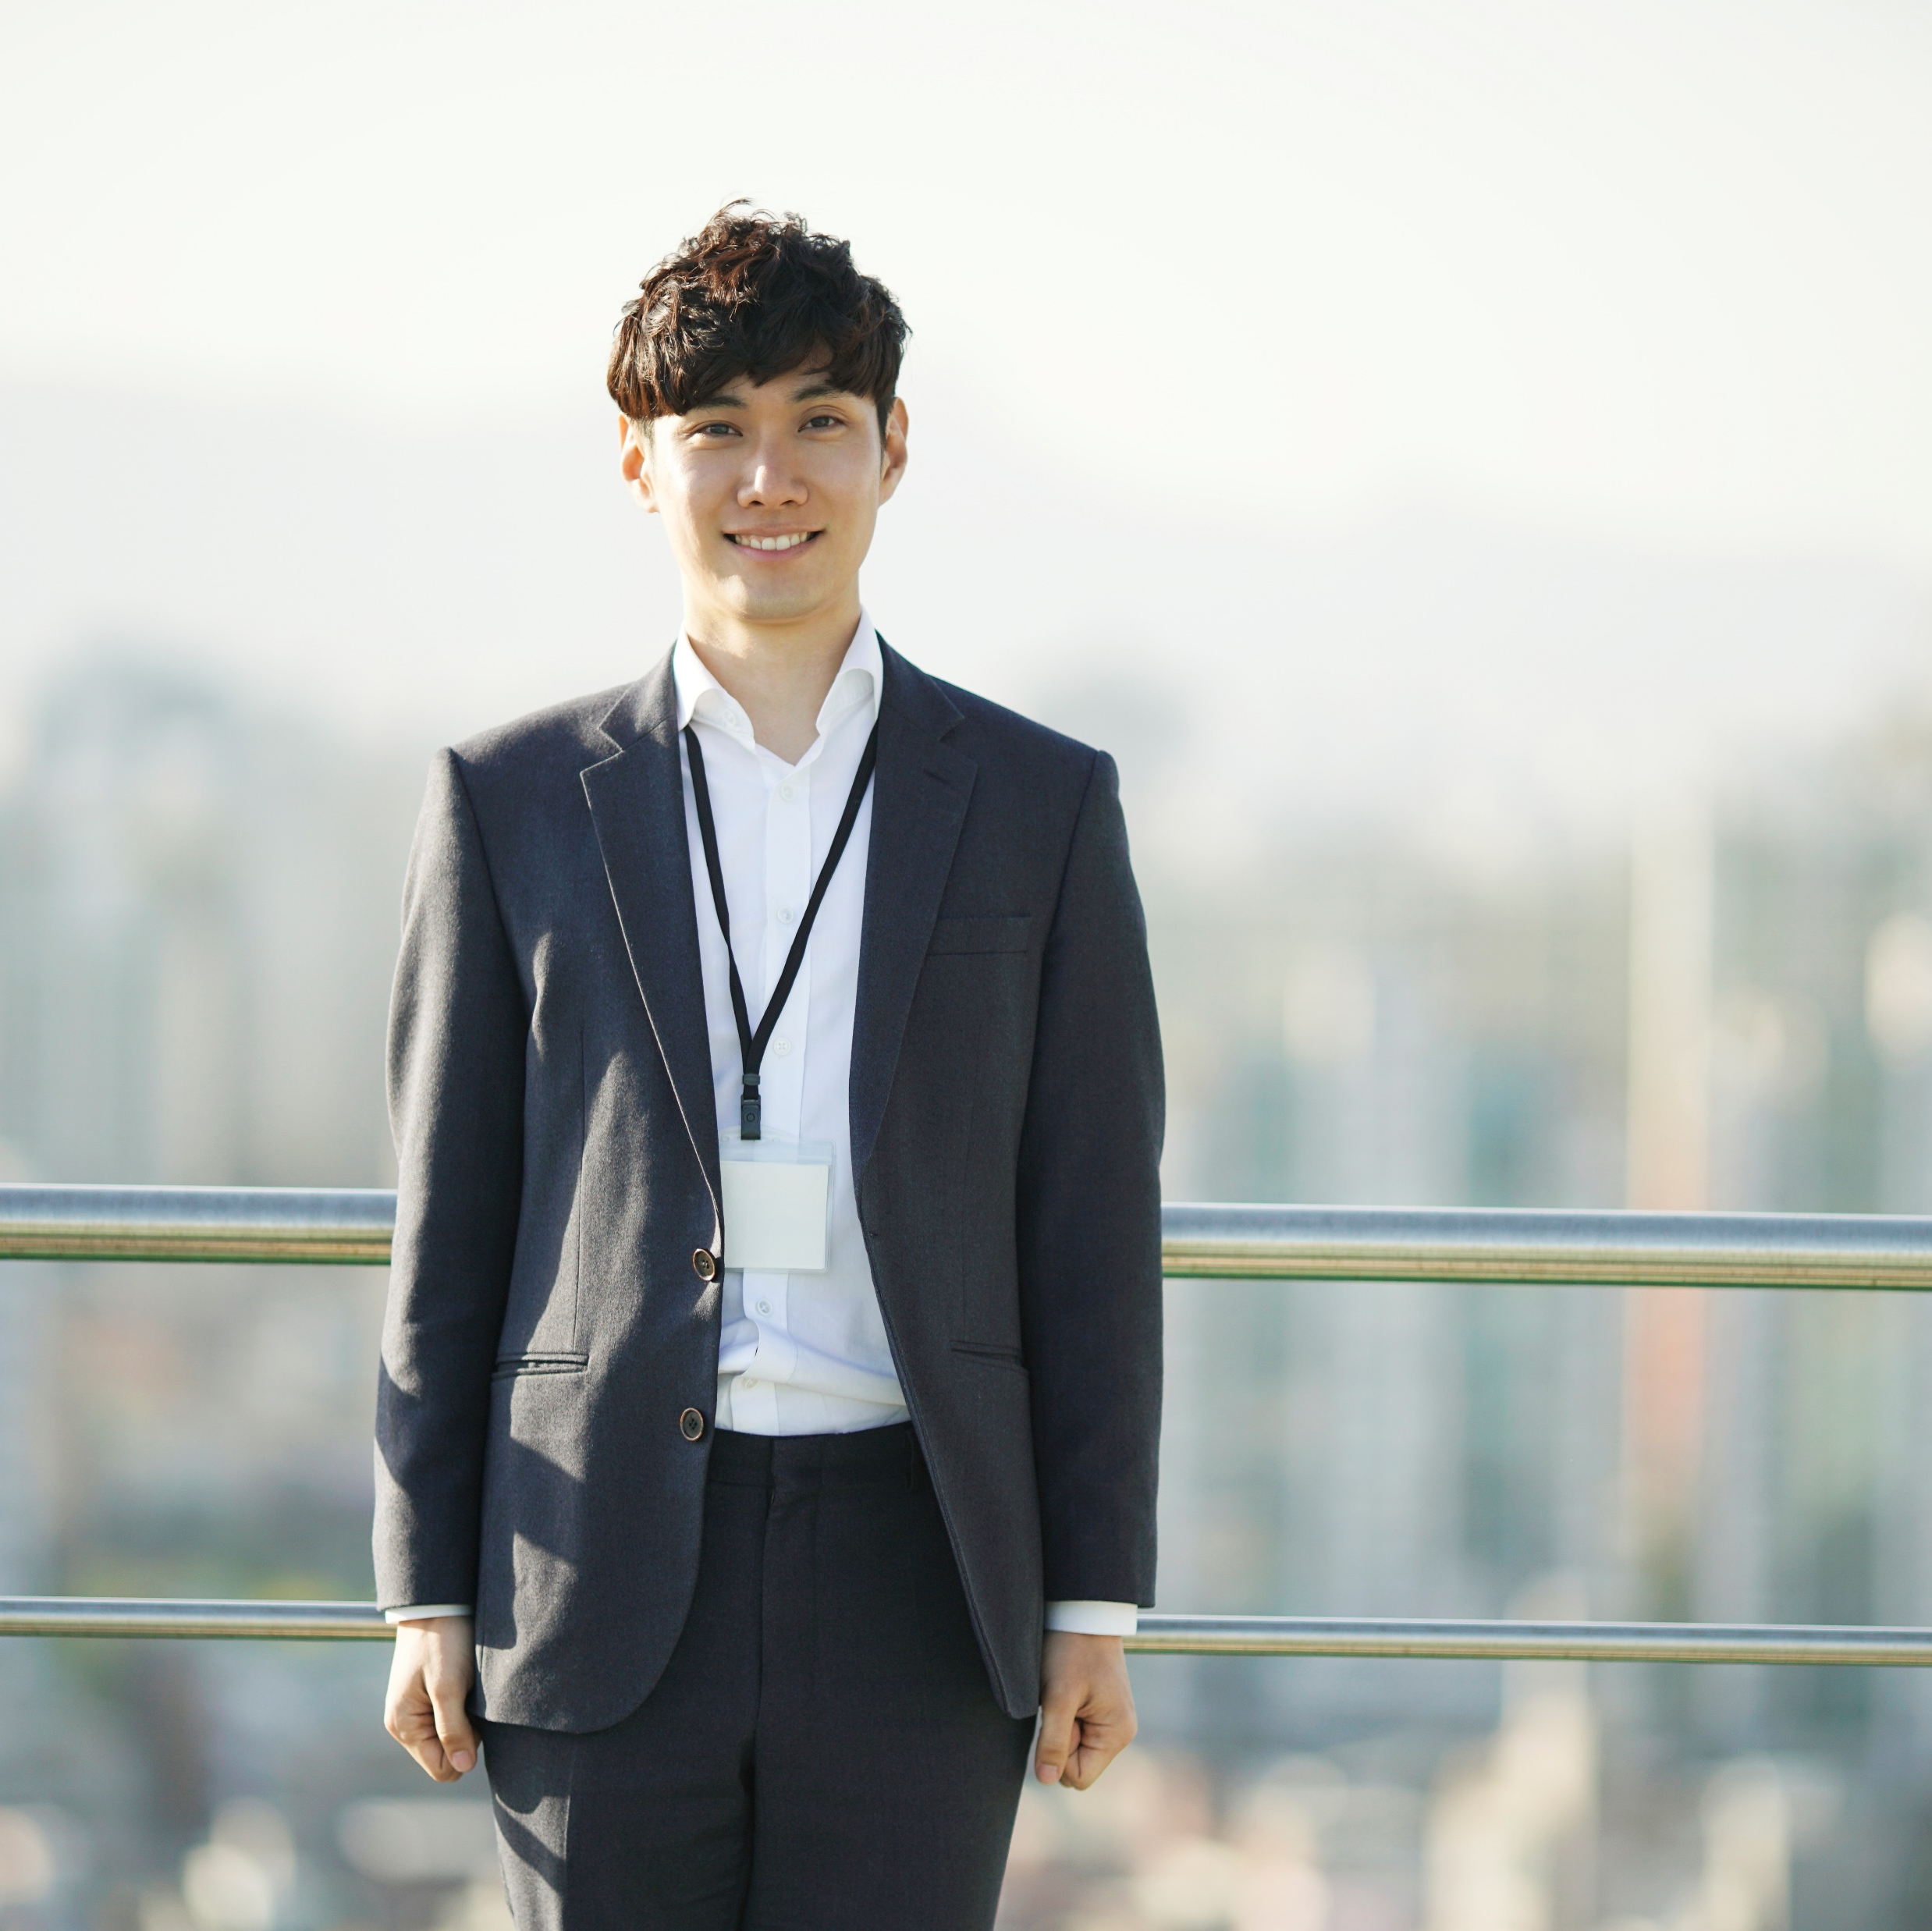



Leadership and executives
Takuma Hayashi​
Mirjam Nilsson​
Flora Berggren​
Rajesh Santoshi​
President
Chief Executive Officer
Chief Operations Officer
VP Marketing

Slide 8
Organization chart
Taylor Phillips
Marketing manager
Kiana Anderson
Natasha Jones
Felix Henderson
Isabel Garcia
Tyler Stein
Office manager
Human resources
Project manager
Copywriter
Intern

Slide 9




Company policies
Keep track of your time
Treat everyone with respect
Report workplace incidents
Review employee handbook

Slide 10
Benefits
Health and dental options
Retirement
Full health and dental coverage for you and your family
Telemedicine available
Generous 401K match and access to a financial advisor for estate planning
Time off
Training and education
Employees start with 2 weeks of vacation with an increase of 1 week every year
Optional sick leave of 1 week available to employees
All national holidays are included in the employee's time
Tuition coverage after 1 year of work
Opportunity to travel to conferences

Slide 11
Performance reviews
At Contoso, we want you to perform your best work. New employees get their work and conduct periodically reviewed by their manager and scored on a 1-5 scale.
Reviews will occur every 3 months with a full review of your entire work after 1 year. More specific details of the review process and related forms can be found in your employee handbook.

Slide 12
Resources

Slide 13




Contact information
Benefits
Employee tip line
206-555-0123
206-555-0100
For any work issues, please contact HR manager Natasha Jones at natasha@contoso.com or at 206-555-0177.
Office manager
Accident report
206-555-0123
206-555-0172
For other work questions or concerns, here's a list of numbers that may help:

Slide 14
Required paperwork
Complete on Day 1
Complete W2 form
Direct deposit form
Employee Handbook acknowledgement
Complete in 30 days
Insurance coverage enrollment
Retirement selection
Workplace training

Slide 15
Summary
We're excited that you're joining the Contoso family. We're happy that you've chosen to be a part of a movement in creating better communication and building communities across businesses.
We wish you the best of luck and have fun!

Slide 16
Thank you
Mirjam Nilsson​
206-555-0146
mirjam@contoso.com
www.contoso.com

